Slide 1


Slide 2

WHY NAVIGATE MATTERS HERE
ESCG Digital, Media, Film & Computing · Level 3 and A Level
At Level 3 you own your progress. Navigate is where you build the evidence that you did.
University, an apprenticeship and the studio, newsroom or technical team you want to join all ask the same question: what can you actually do, and how do you know? Your Digital CV is your answer.
Built across two years, it becomes something a personal statement cannot fake.
By the end of today you will be able to:
Interpret your Skills Assessment results and set a development priority
State a next destination and the entry requirements it carries
Write a reflection that evidences a skill, not just describes an event
Notes:
Level 3 pitch: sentences stay short, the demand goes up. Address them as people who own their own progress — that is the actual step-change from Level 2.
Inferred — please review. This deck covers a wide cohort: Content Creation and Cybersecurity at Eastbourne, Games Art and Film Production at Hastings, T Levels at Hastings (Ore) and Lewes, and Media, Film Studies and Photography A Levels. Two patterns recur. First, students who chose a creative course expecting no exams — the Creative and Design T Level carries a 2.5-hour written paper and Media A Level is 70% examined. Second, students who underestimate the independent study named on their own course page: ten hours a week on Content Creation Level 3. A Level students also arrive expecting Media and Film to be the lighter option and meet real analytical demand instead. Name all of this in week one so the challenge in this deck is pitched, not merely delivered.

Slide 3
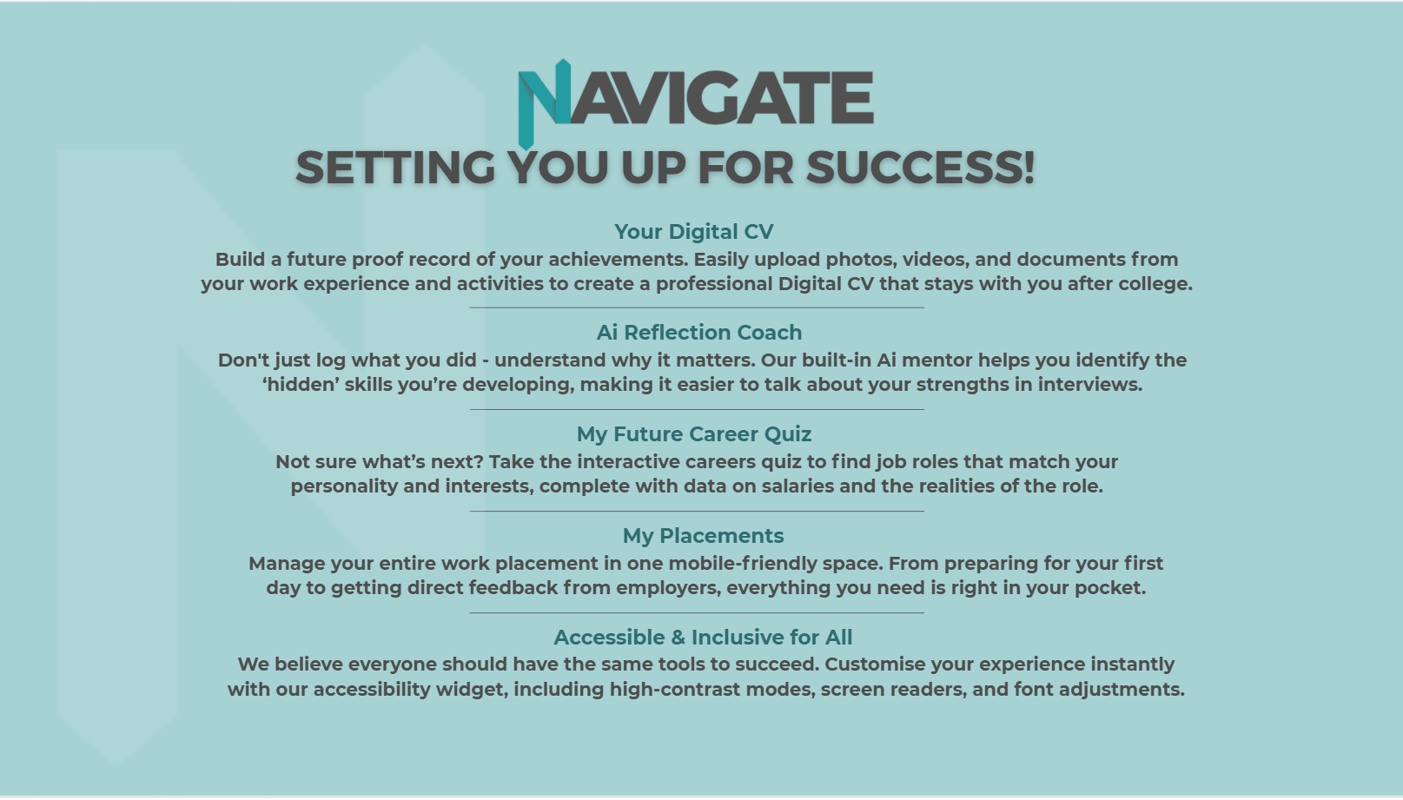

Slide 4


Slide 5
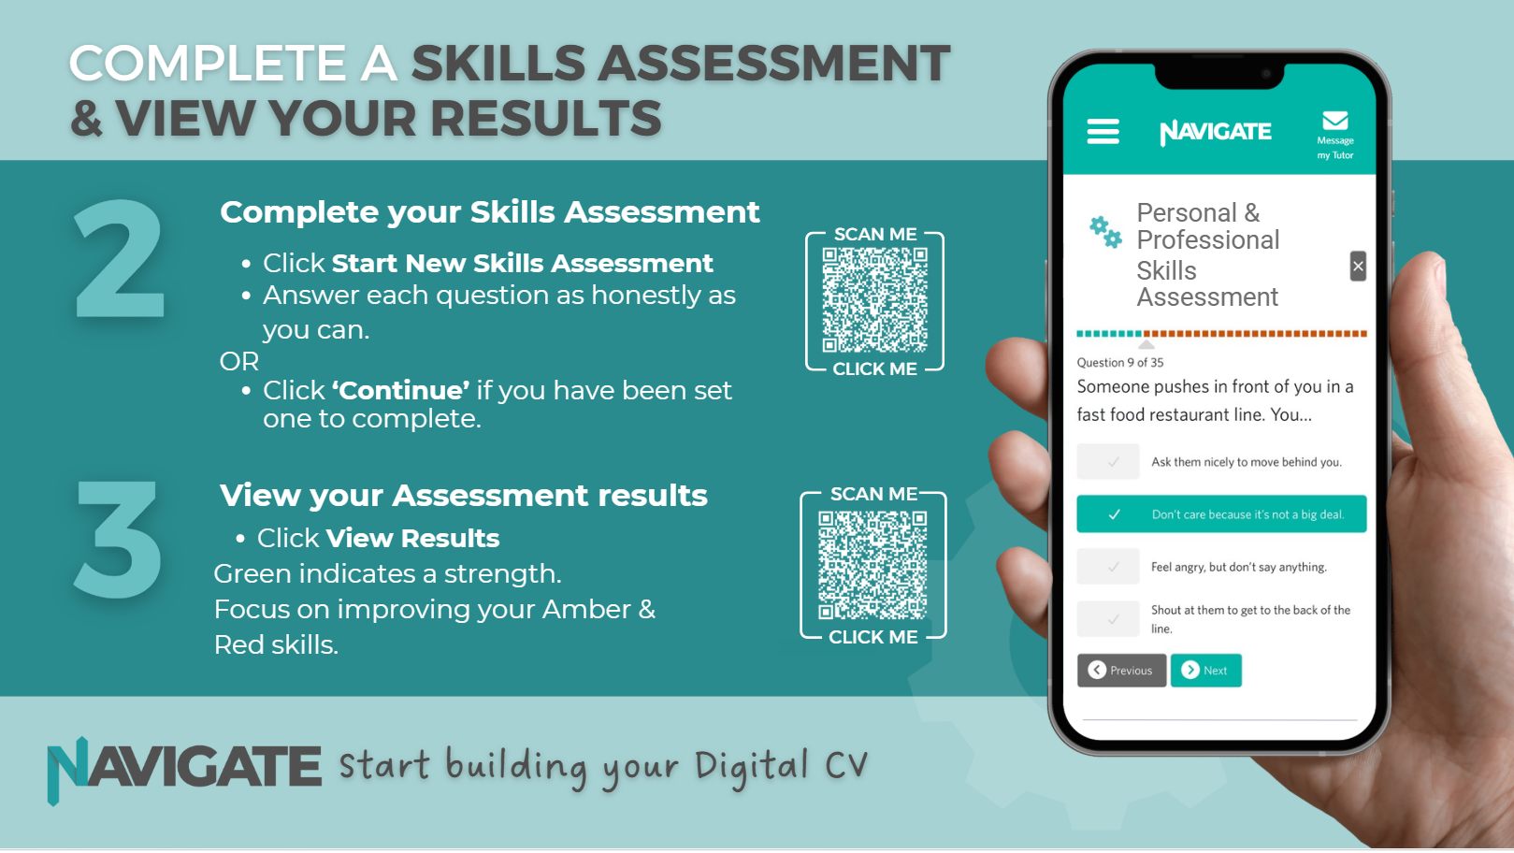

Slide 6
YOUR SKILLS ASSESSMENT
This is a self-report. Its value depends entirely on your honesty — inflate it and you get a useless picture of yourself.
GREEN
Evidenced strength. Prove it in your Digital CV.
You filmed an interview that goes out this week. Afterwards the person asks you to take it out. It is your strongest material. You…
AMBER
Inconsistent under pressure. Most people sit here.
RED
Your development priority this term.
Consider what that actually tests: professional judgement, communication, and the duty of care you carry the moment you work with someone you film, photograph or interview, a client, or a system other people rely on.
Read the Amber list carefully.
Amber is where the real gains are — Red is usually already obvious to you.
Notes:
Consent is a real, assessed professional standard across this department: filming consent, copyright, defamation and editorial ethics are named on the Content Creation Level 3 and T Level pages, and the Photography A Level page requires consent from every subject photographed. The scenario is chosen to be recognisable and to make the duty-of-care point concrete rather than abstract.
A cyber alternative for the Cybersecurity and Digital T Level groups: "During a lab you find a real weakness on a system that is not part of the exercise. You…" — this puts the Computer Misuse Act 1990 in front of students in week one rather than in Year 2. Inferred — please review: likely disclosure triggers include personal material surfacing in self-directed film, photography and journalism work, and unlawful online activity a student may already be involved in. Agree the response route before delivery.

Slide 7
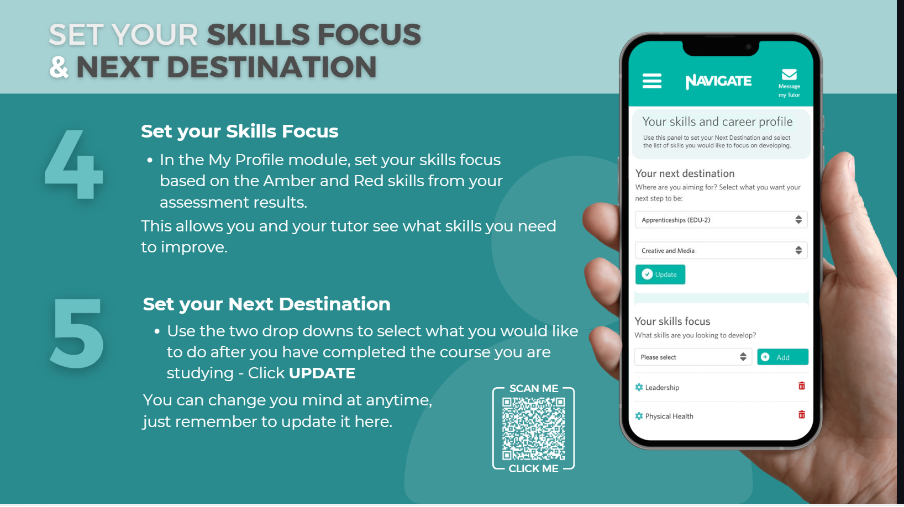

Slide 8
YOUR NEXT DESTINATION
Set it now, with the entry requirements checked. Vague ambition is not a plan.
Where this leads
Two honest points
Media, film, journalism, PR and marketing degrees
Animation, illustration, graphic design, photography degrees
BA (Hons) at University Centre Hastings — a degree without moving
Digital Media Design Foundation Degree; HNC/HND Computing
Higher Apprenticeship at Level 4, 5 or 6, or employment
UCAS runs in Year 2, alongside your external assessments. The material for a personal statement is built in Year 1
Year 1 sets the trajectory of Year 2. It is not a warm-up
Specialist routes open up later: digital forensics, network engineering, editing and post-production, cinematography.
Notes:
Every route listed appears on the ESCG Level 3, T Level and A Level pages for this department. The BA (Hons) progression at University Centre Hastings is named on both the Games Art and Animation and the Photography A Level pages, and it consistently surprises students who had assumed a degree meant moving away. Lead with it for Hastings-based students.
TO CONFIRM before delivery: check degree entry requirements, UCAS tariff points and apprenticeship windows with your Head of Curriculum and the current course pages. Close these published gaps first — the awarding body is not stated for Cybersecurity and Digital Systems Level 3, Film Production Level 3, Media Studies A Level at Hastings, Film Studies A Level at Hastings, or Photography A Level at Lewes. Until those are confirmed, students cannot be given correct UCAS values, specification materials or past papers. Record who confirmed it and when.

Slide 9
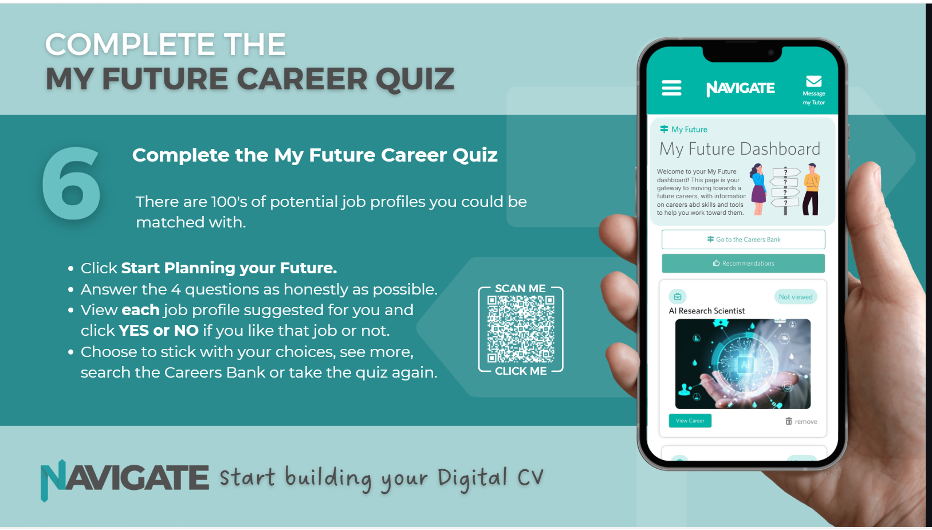

Slide 10
CAREERS THIS LEADS TO
Do not click through the quiz quickly. Interrogate each profile: entry route, qualification level, earnings, and what the job is like day to day.
Journalist; film or TV producer; cyber security analyst
Digital video editor; junior content producer; social media co-ordinator
Games artist; animator; CGI artist; concept artist
FE lecturer or technician in media, film or computing
Art director; production manager; studio manager
SOC analyst; infrastructure technician; digital forensics
The most useful outcome of this quiz is a clear NO. Ruling something out is progress, and it is faster than drifting into it.
Notes:
Roles drawn from the progression sections of the Level 3, T Level and A Level pages across this department, spanning media, film, games, photography and cyber so the whole cohort is represented. The Cyber T Level page is unusually specific about destinations — SOC Analyst, Cybersecurity Technician, Infrastructure Technician — and that specificity is itself motivating. Use it.
The entry-route misconception to correct in week one: that a creative course means no exams. The Creative and Design T Level carries a 2.5-hour written paper on media law and audience research; Media A Level is 70% examined; Film Studies at Lewes is 70% examined. Inferred — please review: "FE lecturer or technician" and "studio manager" are reasonable sector roles but are not named on the ESCG course pages — check before presenting them as ESCG progression.

Slide 11
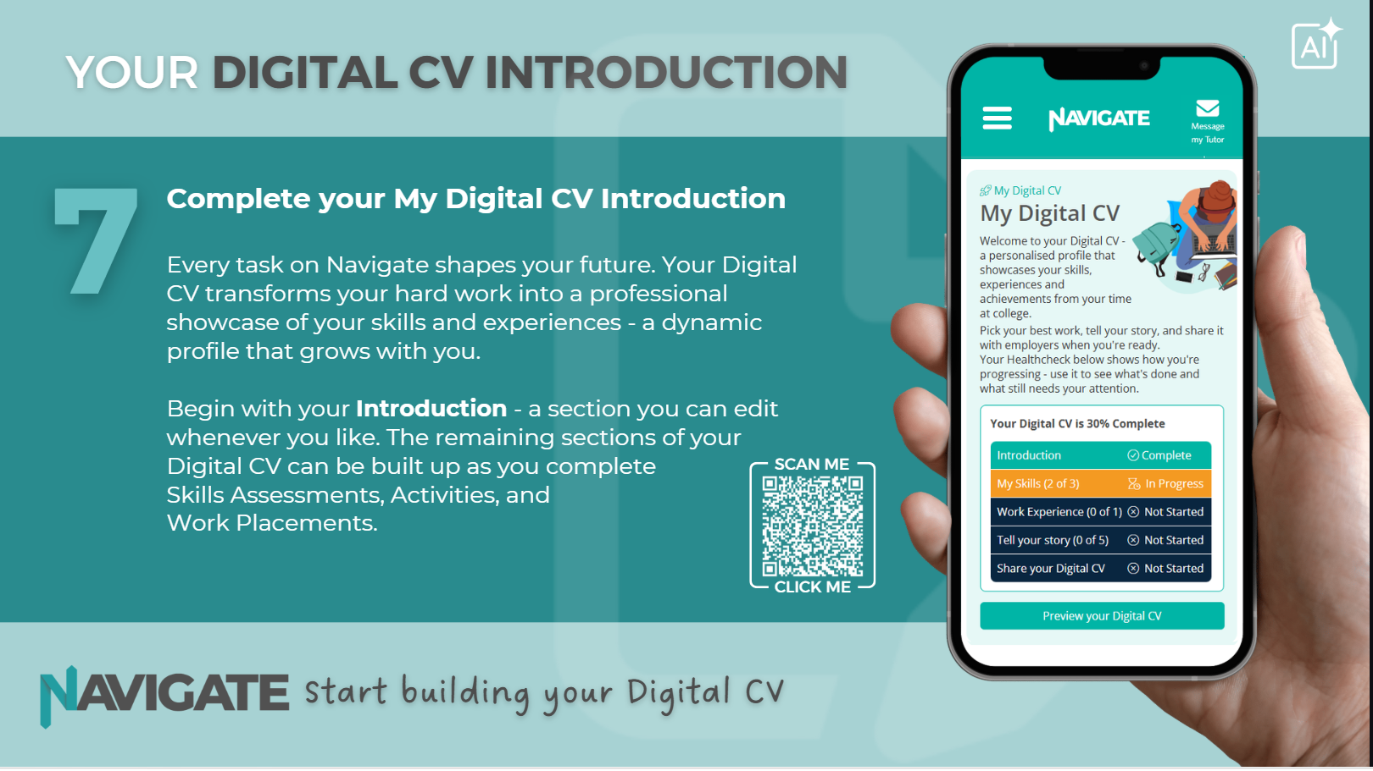

Slide 12
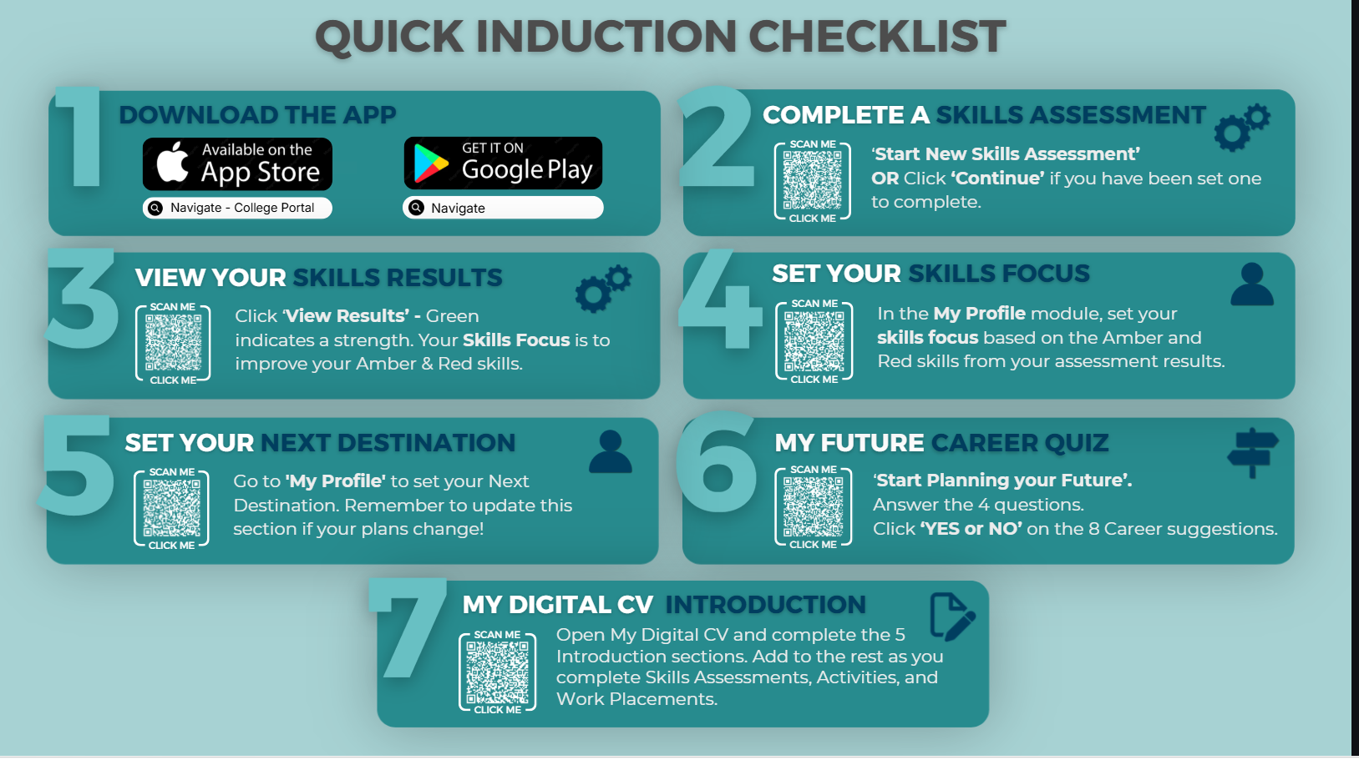

Slide 13
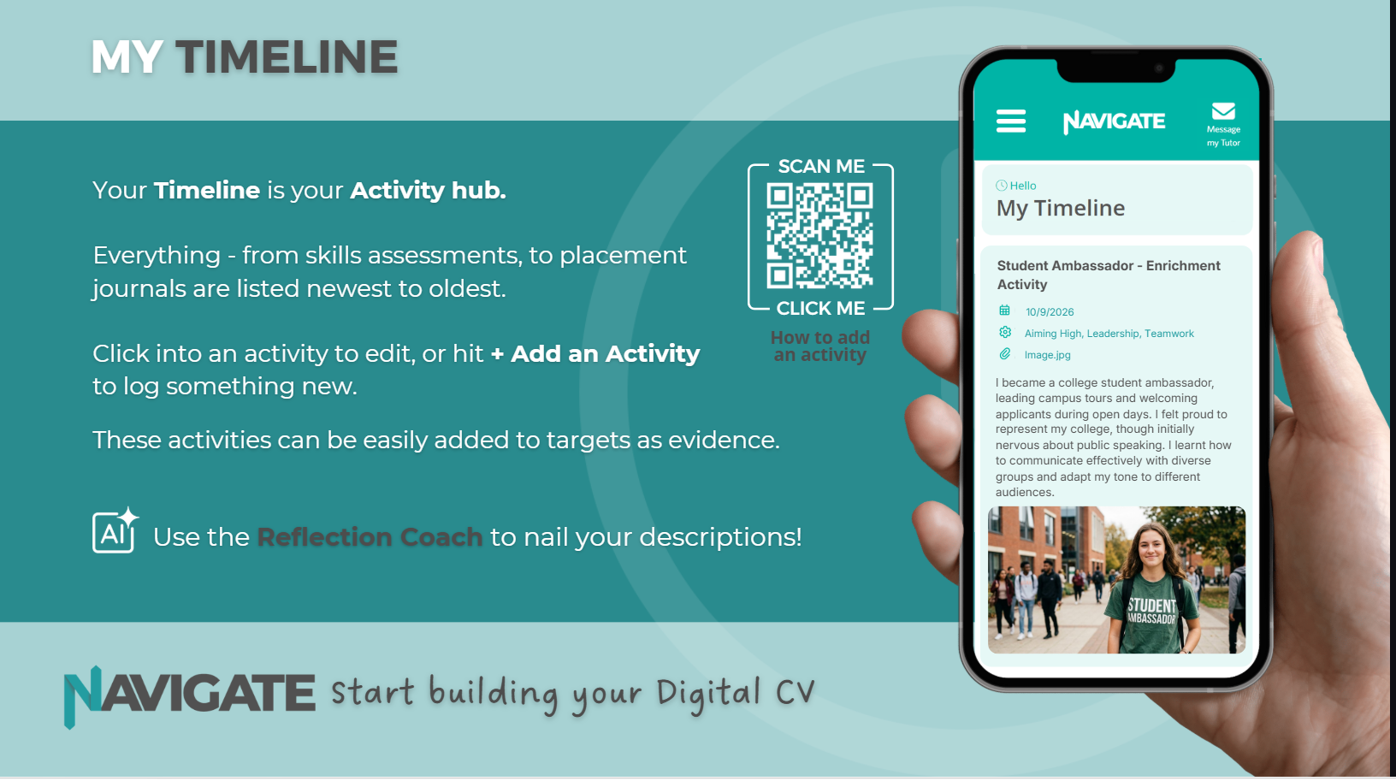

Slide 14
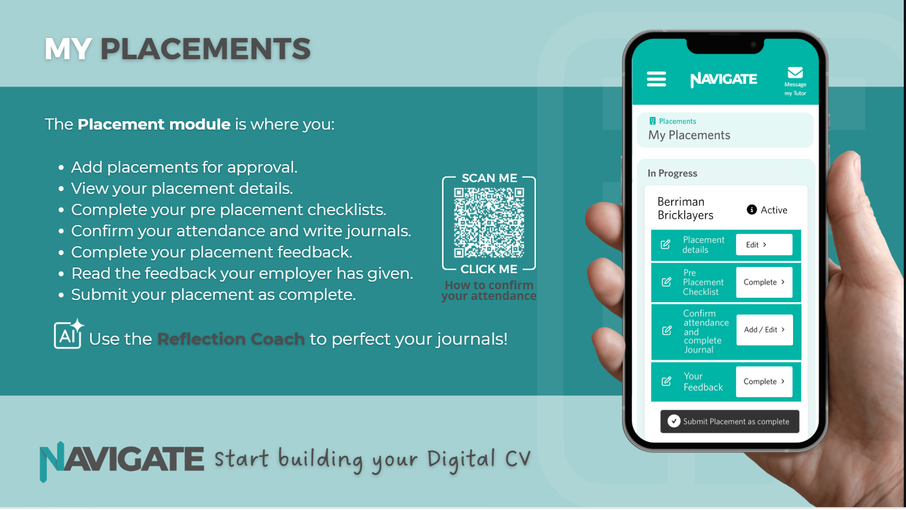

Slide 15
WHAT YOU SHOULD BE LOGGING
Two years of consistent logging becomes a portfolio. Two years of good intentions becomes a panic in February.
Film, audio, graphics and code you plan, make and evaluate
Externally moderated projects and Final Major Projects
Edits, builds and tests — Premiere Pro, DaVinci, Blender
Live media: Youth Radio, Tag magazine, The Depot
Cross-department work — photographing for Hair and Beauty
Visiting media professionals and industry visits
Industry placement — 315 hours on the T Levels
Part-time work — professionalism and communication are the same skills
One entry per activity, logged the same week, tagged to the skills it evidences. Ten minutes now saves an afternoon in Year 2.
Notes:
Anchored to real assessed activity in this department: Eastbourne Youth Radio and Tag magazine on Content Creation Level 3, the nine-project Year 1 schedule on Games Art and Animation, premieres and study days at The Depot on Film Studies at Lewes, the 15-hour practical exam and cross-department collaborations on Photography A Level, and the Employer Set Projects on the T Levels.
Placement wording: 315 hours is the stated minimum on the Creative and Design T Level at Lewes. The Digital and Cyber T Levels at Hastings (Ore) state a mandatory placement but do not publish the hours — confirm with the department before you state a number. Independent study differs too: ten hours a week is stated on Content Creation Level 3 and six hours at Level 2, so this slide should carry your own course’s figure.

Slide 16
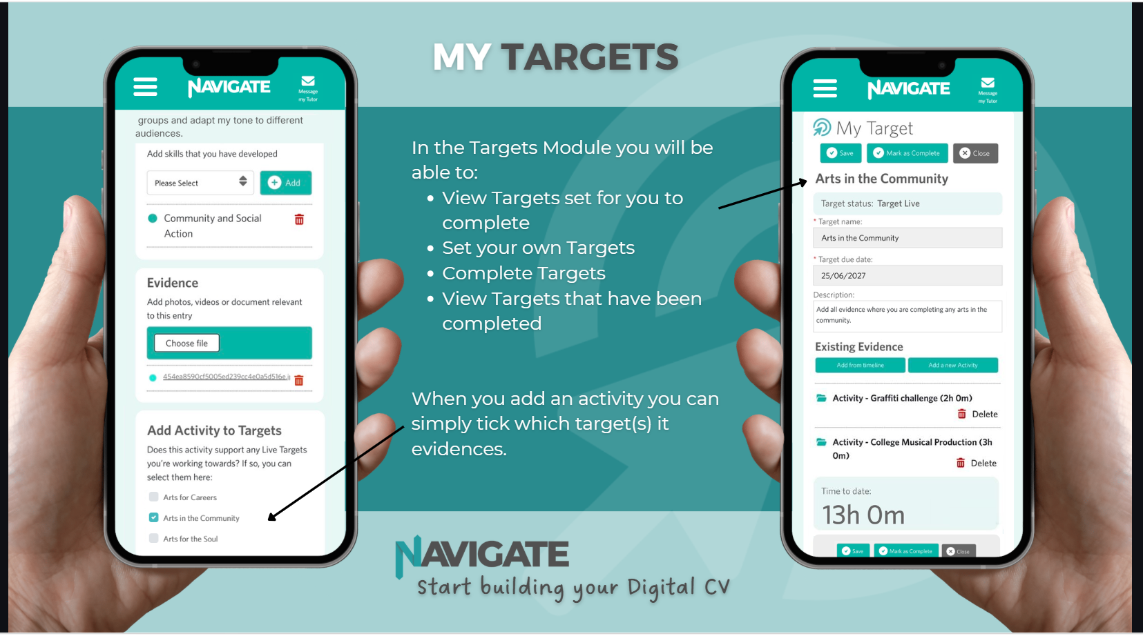

Slide 17
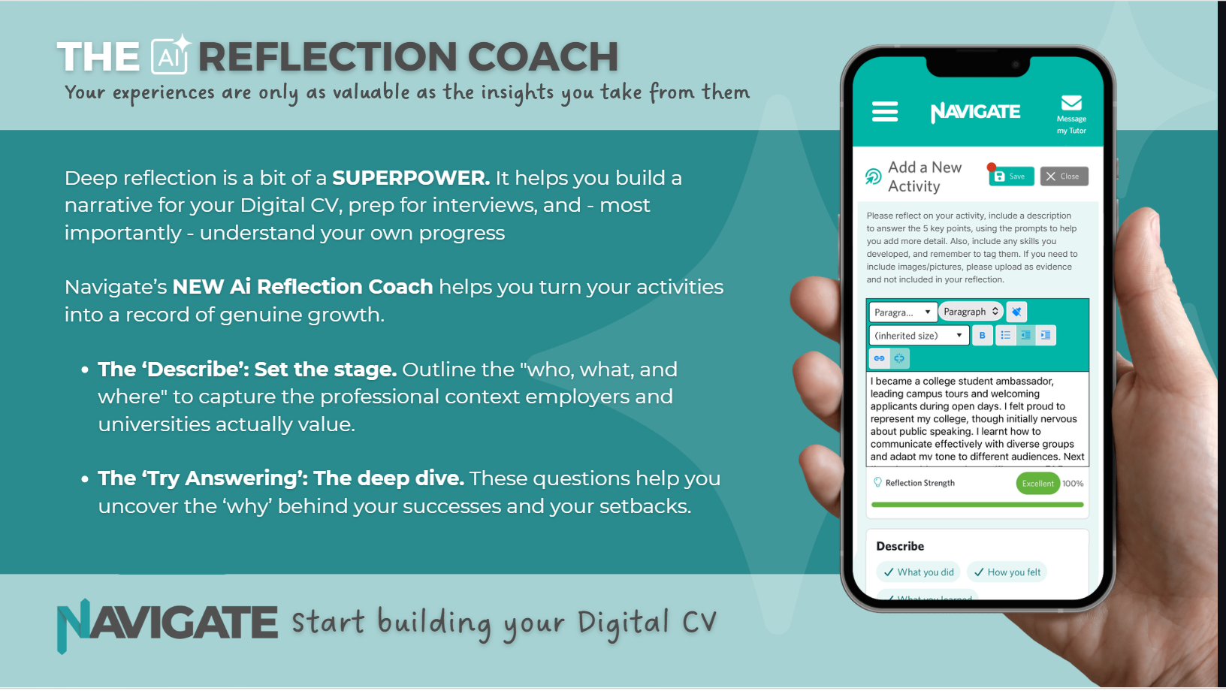

Slide 18
A REFLECTION THAT MEETS THE STANDARD
Reflection is a professional skill, not an admin task. Compare these.
DESCRIPTIVE
ANALYTICAL
“I edited the radio package. It went okay. I was not sure about the sound.”
“I cut a three-minute package for the radio show. The music kept covering the voice, so I dropped the music. That did not fix it: my voice was recorded too far from the mic, so lifting it lifted the room noise as well. I re-recorded close to the mic and the mix cleared. The fault was in the recording, not the edit. Next time I set levels as I record.”
The second names the decision, the reasoning, the evidence and the change in practice — the level a personal statement or a professional portfolio needs.
The Reflection Coach prompts you towards this. It does not do it for you, and an assessor can tell the difference.
Notes:
Worked example set in the live radio production named on the Content Creation Level 3 page. The analytical version models the move from "what happened" to "what I decided, why, and what changed" — the level external moderation and an admissions tutor both read for.
Alternatives if your group is not on the radio strand: Games Art — a character model that would not animate; Photography A Level — a print that failed in the darkroom before the 15-hour exam; Cybersecurity — a vulnerability scan that returned a false positive. Keep the analytical version specific: the decision, the reasoning, the evidence, the change in practice.

Slide 19
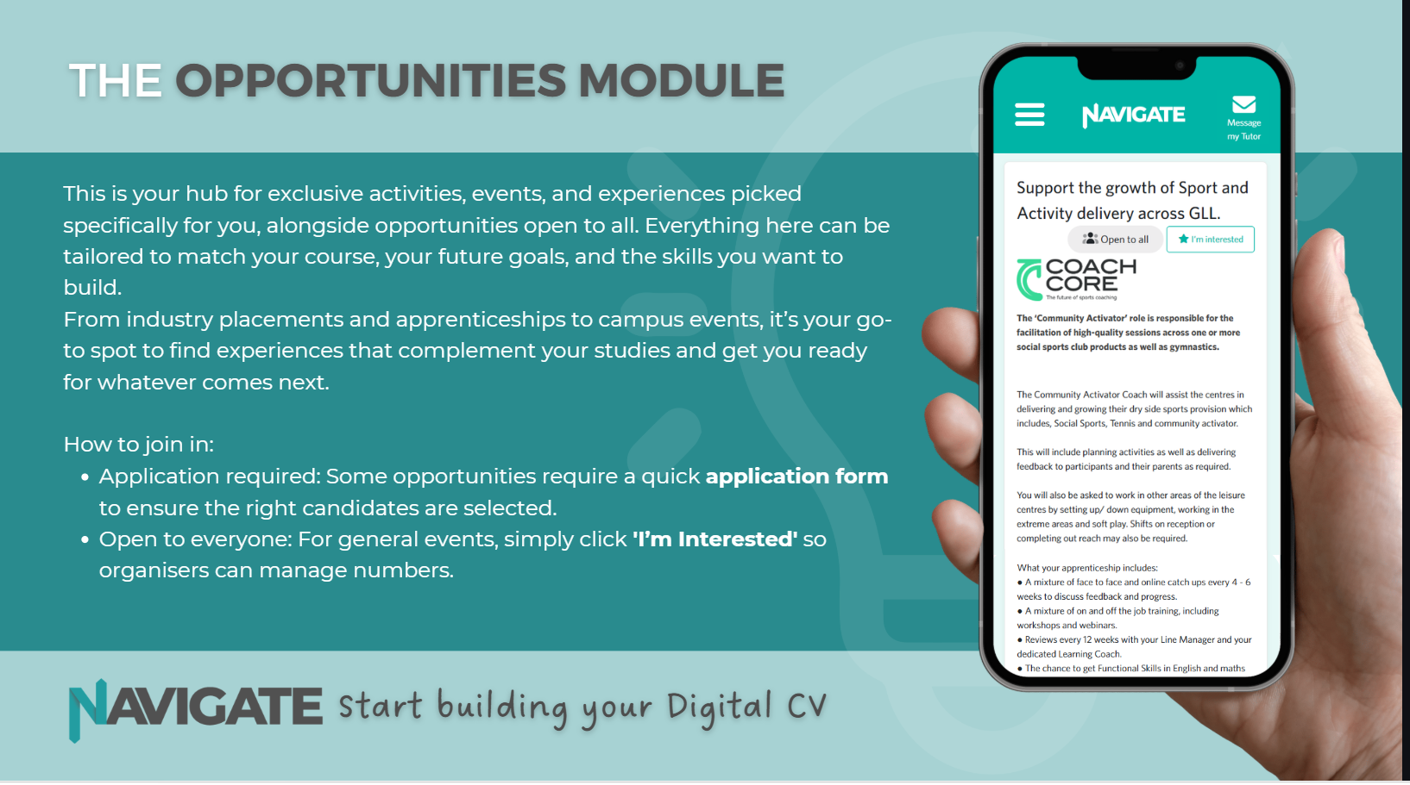

Slide 20
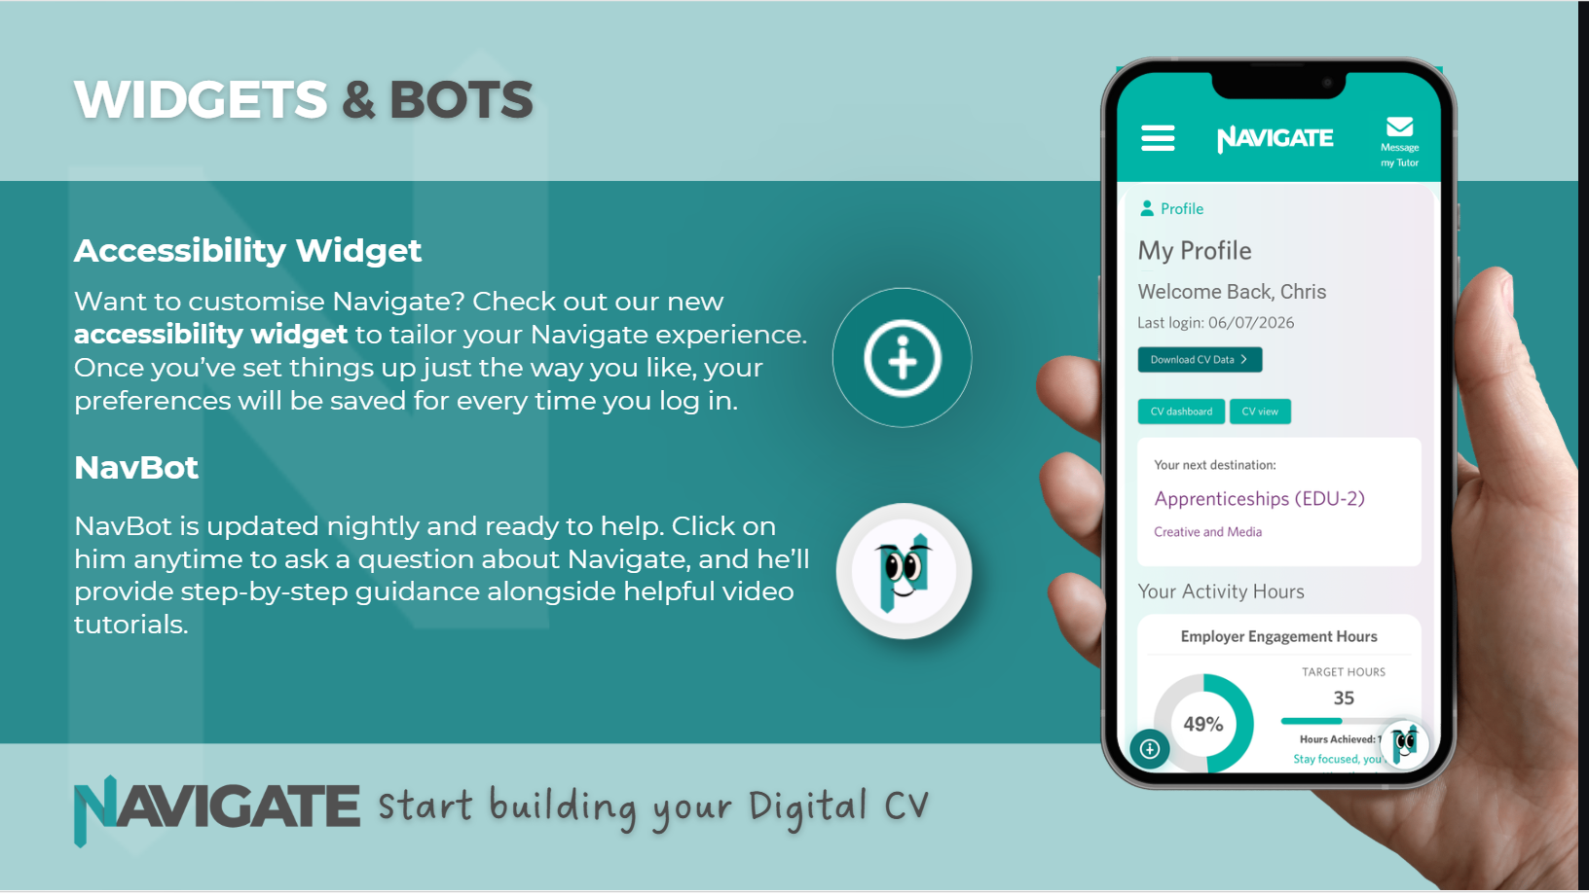

Slide 21
YOUR FIRST TWO WEEKS
Complete these independently by the end of week two.
1. App or shortcut set up
2. Skills Assessment completed honestly
3. Results interpreted — Green, Amber and Red
4. Skills Focus set from your Amber and Red
5. Next Destination set, entry requirements checked
6. Career Quiz completed, every profile reviewed
7. Digital CV Introduction written
8. One activity logged, with a strong reflection
No reminders are coming, and that is deliberate. If you hit a genuine barrier, message your tutor in the app — asking early is a professional skill, not a weakness.
Notes:
Warm but demanding. The independence is named as the point, and the route to help is left wide open so the challenge does not read as abandonment.
Name the deadline, the follow-up and the route to help in your own words: "All eight by the end of week two. I check them in the week three tutorial, and I am in the studio at Thursday lunchtime." Independence reads as abandonment unless the support route is stated as clearly as the expectation. Warm and demanding are not opposites.

